Slide 1
Bellman-Ford Algorithm
CSE 2202: Algorithm Analysis and Design Laboratory
Most. Kaniz Fatema Isha
Md Mehrab Hossain Opi

Slide 2
Problem with Dijkstra
Previously we learned Dijkstra’s Algorithm.
Do you know what is the problem with this algorithm.
Consider the following graph.
What is the cost of the shortest path from node 1 to node 3?
2
2
-2
1
2
3
-5
4

Slide 3
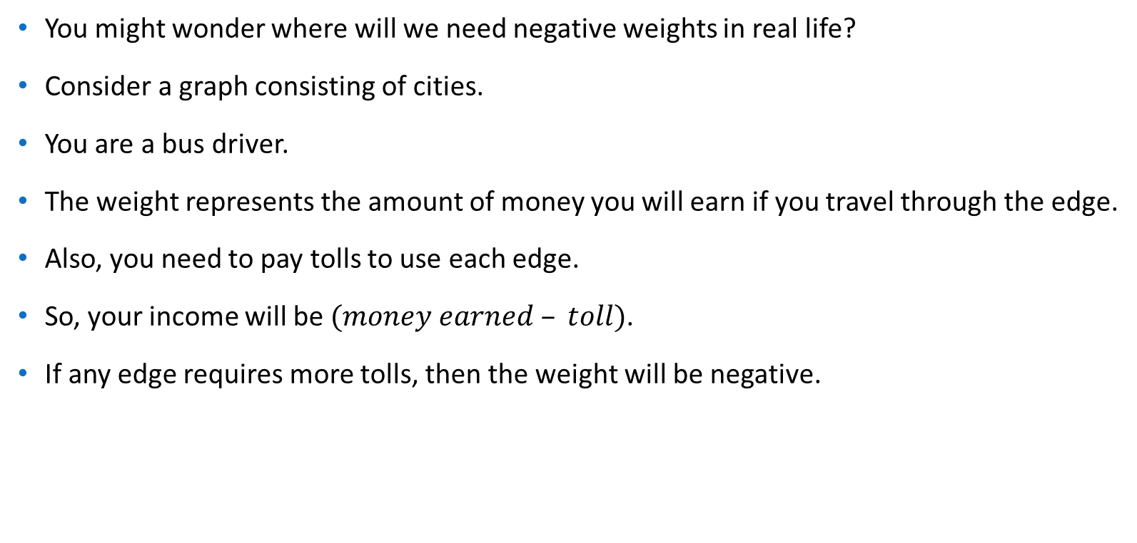
Negative Weight

Slide 4
Problem with Dijkstra’s Algorithm
Negative weight edges can create negative weight cycles.
a cycle that will reduce the total path distance by coming back to the same point.
Dijkstra’s algorithm does not work if the graph contains a negative cycle.
Going through a cycle reduces path length and produces wrong result.
Today we will learn a new algorithm that works on graph with negative cycles.
The algorithm is called Bellman-Ford Algorithm.

Slide 5
Bellman-Ford Algorithm
Like Dijkstra’s Algorithm, Bellman-Ford algorithm also uses relaxation.
Do you remember what relaxation is?
In Dijkstra’s Algorithm, we only used the outgoing edges of a selected node in each iteration.
Hope you can remember it.
But in Bellman-Ford algorithm, we will use all the edges in each iteration.
The process of relaxing an edge (u,v) consists of testing whether going through vertex u
improves the shortest path to vertex v found so far and, if so, updating distance[v]

Slide 6
Bellman-Ford Algorithm
Let’s see how Bellman-Ford Algorithm works now.
We will consider the following graph
1
4
2
6
10
2
0
3
6
6
1
15
6
2
5

Slide 7
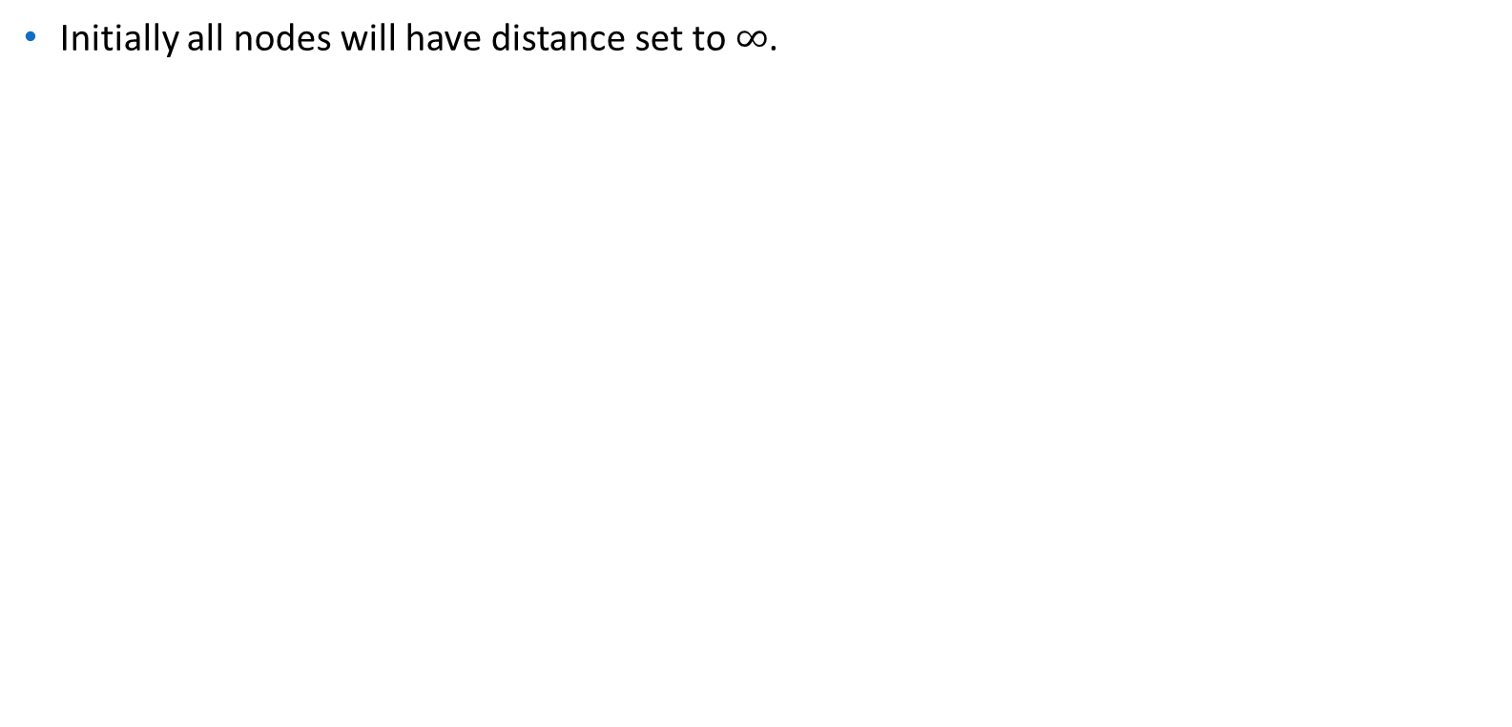







Bellman-Ford Algorithm
1
4
2
6
10
2
0
3
6
6
1
15
6
2
5

Slide 8

Bellman-Ford Algorithm
Let node number 0 be the source node.
We will set the distance of node 0 to 0.
1
4
2
6
10
2
0
3
6
6
1
15
6
2
5

Slide 9
Bellman-Ford Algorithm
Now we will start our iteration of relaxation.
In each iteration we will try to relax all the edge.
1
4
2
6
10
2
0
3
6
6
1
15
6
2
5

Slide 10

Bellman-Ford Algorithm
1
4
2
6
10
2
0
3
6
6
1
15
6
2
5

Slide 11
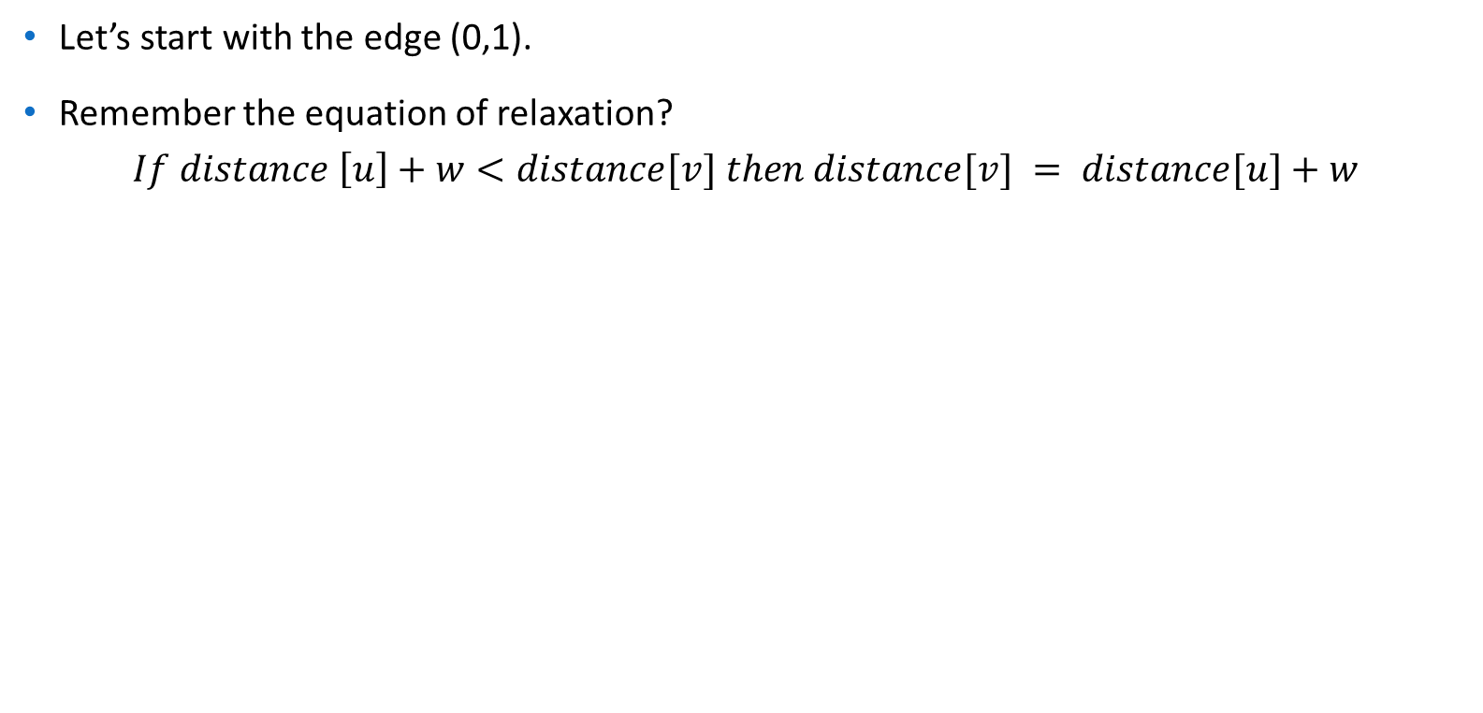







Bellman-Ford Algorithm
1
4
2
6
10
2
0
3
6
6
1
15
6
2
5

Slide 12









Bellman-Ford Algorithm
1
4
2
6
10
2
0
3
6
6
1
15
6
2
5

Slide 13









Bellman-Ford Algorithm
Edge | Weight
(0,1) | 2
(4,6) | 2
(3,4) | 10
(0,2) | 6
(5,6) | 6
(2,3) | 1
(1,3) | 6
(5,3) | 15
Edge Relaxation
1
4
2
6
10
2
0
3
6
6
1
15
6
2
5

Slide 14







The Algorithm
After iterating through all the edges one time we get the following distances.
Have we got the shortest distance for all the nodes?
1
4
2
6
10
2
0
3
6
6
1
15
6
2
5

Slide 15







The Algorithm
We need to iterate through all the edges again.
After second iteration we get the following distances.
We still don’t have the shortest distance of node 6.
1
4
2
6
10
2
0
3
6
6
1
15
6
2
5

Slide 16
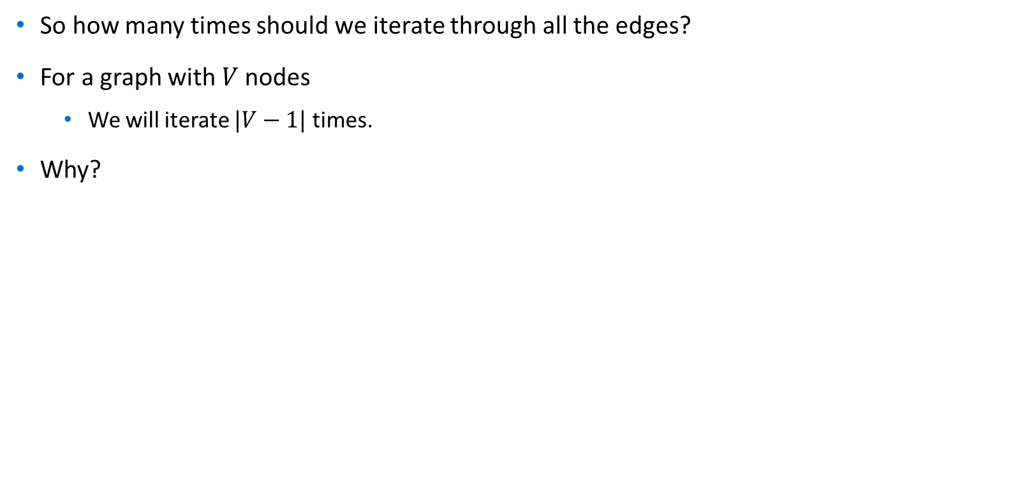
The Algorithm

Slide 17
Reasoning
What happens when we iterate through all edges for the first time?
After the first iteration, we guarantee that the shortest paths using at most one edge are found.
After the second iteration, the shortest paths using at most two edges are found, and so on.

Slide 18
Reasoning
The shortest path between any two vertices in a graph with no negative weight cycles can have at most 𝑉−1 edges.
A path with more than 𝑉−1 edges would necessarily involve revisiting some vertices, implying a cycle.
Since cycles can only increase the number of edges and the path with fewer edges (up to 𝑉−1) would be the shortest, 𝑉−1 iterations are sufficient.

Slide 19
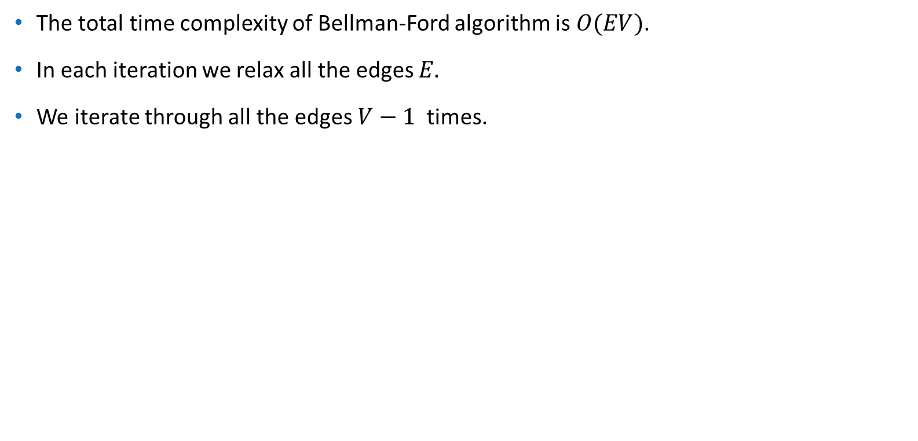
Time Complexity

Slide 20
Negative Cycle Detection
To detect if the graph contains any negative cycle reachable from source, we relax all the edges 1 more times.
If the distance of any node is updated, we can say a negative cycle exist.

Slide 21
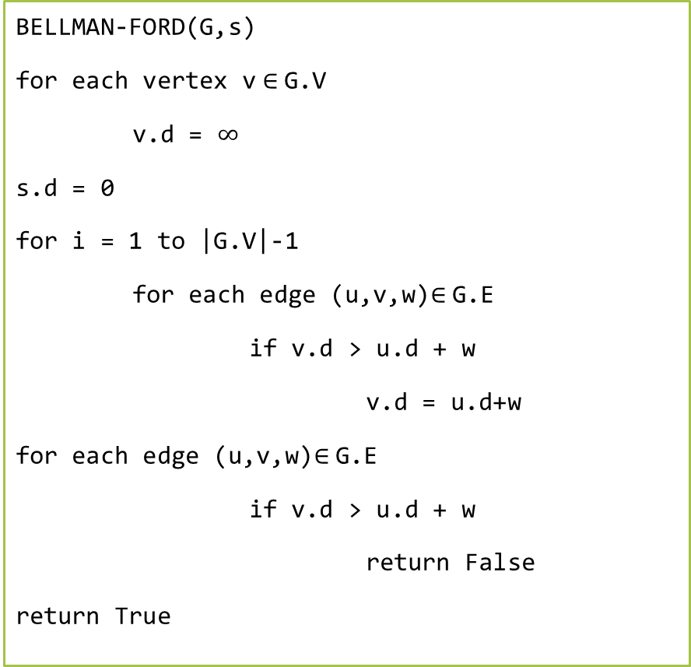
Pseudocode
0
G is a weighted directed graph.
V is the set of vertices.
E is the set of edges.
G = (V,E)
s is the source node.
1
1
-2
2
1
-5
3
1
The function returns True if no negative cycle exists.
4

Slide 22
References
Introduction to Algorithm, 4th ed, Leiserson, Charles Eric, Ronald L. Rivest, Thomas H. Cormen, and Clifford Stein.
Dijkstra’s Algorithm for Adjacency List Representation | Greedy Algo-8 – GeeksforGeeks
Dijkstra's Shortest Path Algorithm using priority_queue of STL - GeeksforGeeks
Dijkstra on sparse graphs - Algorithms for Competitive Programming (cp-algorithms.com)

